Slide 1
Variables

Slide 2
Variables
It’s a named memory location
A variable is only a name given to a memory location, all the operations done on the variable effects that memory location.
The value stored in a variable can be changed during program execution.

Slide 3
Scope
Scope determines the accessibility or visibility of variables to JavaScript.
There are three types of scope in JavaScript:
Global scope
Function (local) scope
Block scope (new with ES6)

Slide 4
Global scope
Variables declared outside a function are in the global scope.
Global variables can be accessed and changed in any other scope.

Slide 5
Function (local) scope
Variables defined within a function are in local scope and are not accessible in other functions.
Each function, when invoked, creates a new scope, therefore variables with the same name can be used in different functions.

Slide 6
Block scope (new with ES6)
Block scope includes if statements and loops, or any other code wrapped in {}.
When invoked, they don’t create a new scope.
Variables declared inside a block scope will remain in the scope they were already in.

Slide 7
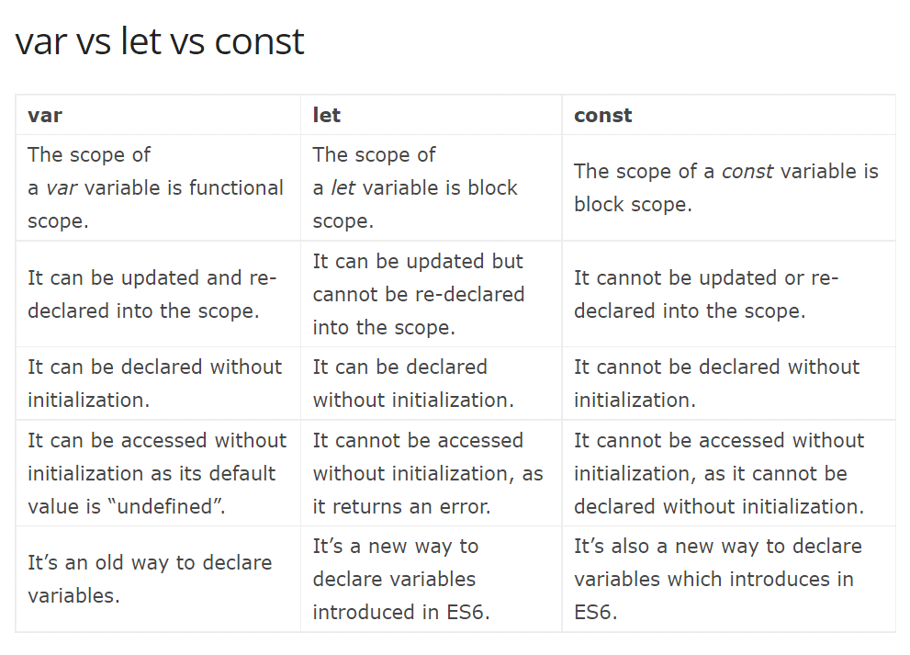

Slide 8
Datatypes
JavaScript provides different data types to hold different types of values.
There are two types of data types in JavaScript.
Primitive data type
Non-primitive (reference) data type
JavaScript is a dynamic type language, means you don't need to specify type of the variable because it is dynamically used by JavaScript engine.

Slide 9
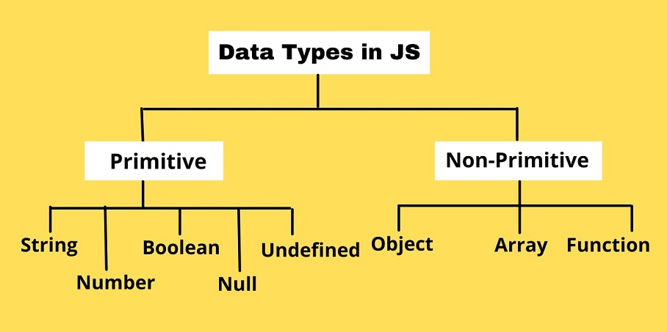

Slide 10
1 String
Single quotes: 'Hello'
Double quotes: "Hello"
Backticks: `Hello`
For example,
//strings example
var name1 = "ram";
var name2 = 'hari';
console.log( `The names are ${name1} and ${name2}`);

Slide 11
1 String
String is used to store text. In JavaScript, strings are surrounded by quotes:
Single quotes and double quotes are practically the same and you can use either of them.
Backticks are generally used when you need to include variables or expressions into a string. This is done by wrapping variables or expressions with ${variable or expression} as shown above.

Slide 12
2 Number
Number represents integer and floating numbers (decimals and exponentials).
For example,
var n1 = 3;
var n2 = 3.433;
var n3 = 3e5 // 3 * 10^5
console.log(n1, n2, n3);

Slide 13
3 Boolean
This data type represents logical entities.
Boolean represents one of two values: true or false.
It is easier to think of it as a yes/no switch.
For example,
const dataChecked = true;
const valueCounted = false;

Slide 14
4 undefined
The undefined data type represents value that is not assigned. If a variable is declared but the value is not assigned, then the value of that variable will be undefined.
For example,
let name1;
console.log(name1); // undefined

Slide 15
5 null
In JavaScript, null is a special value that represents empty or unknown value.
For example,
const number = null

Slide 16
7 Object
An object is a complex data type that allows us to store collections of data.
For example,
const student = {
firstName: 'ram',
lastName: null,
class: 10
};console.log(student.firstName, student.lastName, student.class);

Slide 17
Array
An array can hold many values under a single name, and you can access the values by referring to an index number.
Syntax:
const array_name = [item1, item2, ...];
Eg:
const cars = ["Saab", "Volvo", "BMW"];

Slide 18
Function
Its a block of code designed to perform a particular task.
A function is executed when "something" invokes it
Syntax
function name(parameter1, parameter2, parameter3) { // code to be executed }
Eg function sum(a, b){
var c = a+b;
return c;
}
console.log(sum(2,2));

Slide 19
TASKS
var Name="Max";
var age=34;
//display console as "Hi...My name is Max...34 years old..."
TASK 2
//Write a program to swap two numbers together
var n1=6
var n2=7
//before swap n1=6 n2=7
//After swap n1=7 n2=6

Slide 20
TASKS
What is JavaScript's primary role in web development?
Name some non-browser environments that use JavaScript?
Describe JavaScript as a prototype-based language.?
In what sense is JavaScript considered a multi-paradigm language?
Explain the term "dynamic language" in the context of JavaScript.?
What is the role of ECMAScript in defining JavaScript standards?
Why is it mentioned that JavaScript is a single-threaded language?
Differentiate between imperative and declarative programming styles in JavaScript.?

